Slide 1
Regulation of TRPC Channel Mediated Proarrhythmic Calcium Activity
Angela M. Kwiatek PhD
January 3rd, 2011

Slide 2
Atrial Fibrillation (AF)
Most common type of arrhythmia.
In 2010, 2.66 million will have AF. By 2050, an estimated 12 million will have AF.
For more than two decades, mortality rate has been increasing.
Heart failure and stroke are most common comorbidities.
Atrial fibrillation is present in nearly 50% of all patients with congestive heart failure.
Atrial Fibrillation Fact Sheet, Centers for Disease Control and Prevention, February 2010.

Slide 3
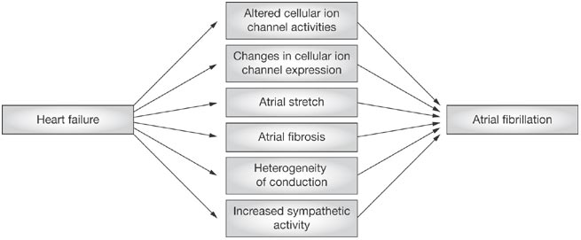
Mechanisms of Heart Failure Induced Atrial Fibrillation
Morrison TB. et al. Nat Clin Pract Cardiovasc Med (2008)

Slide 4
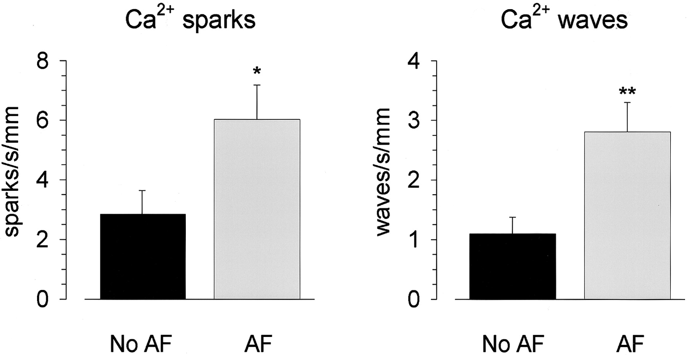
Myocytes from AF Patients Have More Ca²⁺ Sparks and Waves
16 Patients
8 Patients
16 Patients
8 Patients
Hove-Madsen L. et al. Circulation (2004)
Notes:
Tissue samples were carefully obtained from the right atrial appendage just before atrial cannulation for cardiopulmonary bypass and were immediately taken to the laboratory.Frequency of Ca²⁺ sparks and Ca²⁺ waves in atrial myocytes from 16 patients without episodes of AF (no AF) and from 8 patients with AF. Patients with AF showed a higher frequency of Ca²⁺ sparks (*P<0.05) and Ca²⁺ waves (**P<0.01) than patients without AF.

Slide 5
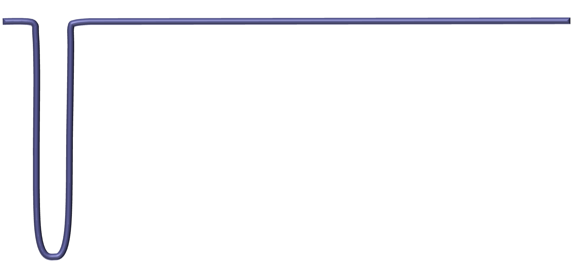
Normal Calcium Signaling in Atrial Myocytes
Cardiomyocyte
Na⁺/Ca²⁺
Exchanger
Sarcoplasmic Reticulum
L-Type
RyR
ATPase
Troponin
Action Potential
Myosin
Tropomyosin
Ca²⁺ Concentration
Contractile Force
T tubule
Notes:
An action potential travels down the T tubules, depolarization spreads through the T tubule, calcium is released from the sarcoplasmic reticulum, Calcium binds to troponin.
Troponin changes shape and pulls tropomyosin out of the myosin head binding sites.
and myosin binds actin. approximately 20 milliseconds after stimulation, the peripheral Ca²⁺ signal can reach 1 µM. However, owing to the lack of inward spreading, the Ca²⁺ concentration declines sharply with distance away from the sarcolemma, and the centre of the cell barely shows an increase over the normal prestimulated Ca²⁺ level of 100 nM

Slide 6
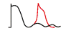
Abnormal Calcium Signaling During Atrial Fibrillation
↑ Na⁺ Entry Through Na⁺/Ca²⁺ Exchanger
Cardiomyocyte
Na⁺/Ca²⁺
Exchanger
Sarcoplasmic Reticulum
↑ Ca²⁺ Uptake into SR Through Ca²⁺ ATPase (SERCA)
↑ Ca²⁺ Entry Through L-Type Ca²⁺ Channels
↑ Systolic Ca²⁺ Release from SR
Sarcoplasmic Reticulum Overload
L-Type
↑ Diastolic Ca²⁺ Release from SR
RyR
ATPase
Triggered Activity
Delayed Afterdepolarizations
T tubule
Notes:
An action potential travels down the T tubules, depolarization spreads through the T tubule, calcium is released from the sarcoplasmic reticulum, Calcium binds to troponin.
Troponin changes shape and pulls tropomyosin out of the myosin head binding sites.
and myosin binds actin. approximately 20 milliseconds after stimulation, the peripheral Ca²⁺ signal can reach 1 µM. However, owing to the lack of inward spreading, the Ca²⁺ concentration declines sharply with distance away from the sarcolemma, and the centre of the cell barely shows an increase over the normal prestimulated Ca²⁺ level of 100 nM

Slide 7
Conditions with Accentuated Gq Signaling
Hypertension
  G_{q}-coupled receptors for angiotensin-II and catecholamines are major players in hypertension.
Pathological Hypertrophy/Congestive Heart Failure
  Overexpression of G_{q} or G_{q}-coupled receptors lead to dilated cardiomyopathies and the development of CHF.

Slide 8
Gq Signaling Provides Sustained Increases in Intracellular Ca²⁺
Endoplasmic Reticulum Store Release
Calcium Entry through TRPC Channels
1.00
1.00
0.75
0.75
334/380 Ratio
334/380 Ratio
0.50
0.50
Throbmin
0.25
0.25
0 mM Ca²⁺
1.5 mM Ca²⁺
Throbmin
0.00
0
150
300
450
600
0.00
0
150
300
450
600
Time (sec)
Time (sec)
Notes:
Normal EC coupling calcium signaling is very transient and may not provide the sustained increases in intracellular calcium concentration to produce arrythmogenic calcium activity. The Gq signaling pathway provides that sustained increase. In endothelial cells, when the Gq signaling pathway is stimulated by Thrombin, calcium concentration is increased for a minimum of 5 minutes. When endothelial cells are treated in the absence of extracellular calcium, there is transient increase in intracellular calcium, however when calcium is added to the extracellular medium calcium enters the cells and increases the intracellular calcium concentration for at least 5 minutes. The channels that may mediate that calcium entry are called transient receptor potential classical channels (TRPC)

Slide 9
G_{q} Mediated Calcium Signaling
α₁ adrenoceptors
Angiotensin₁ receptors
Endothelin_{B} receptors
Cardiomyocyte
G_{q}PCR
TRPC
PIP₂
IP₃
PLC
DAG
G_{αq}
IP₃R
Sarcoplasmic Reticulum
T tubule
Notes:
An action potential travels down the T tubules, depolarization spreads through the T tubule, calcium is released from the sarcoplasmic reticulum, Calcium binds to troponin.
Troponin changes shape and pulls tropomyosin out of the myosin head binding sites.
and myosin binds actin. approximately 20 milliseconds after stimulation, the peripheral Ca²⁺ signal can reach 1 µM. However, owing to the lack of inward spreading, the Ca²⁺ concentration declines sharply with distance away from the sarcolemma, and the centre of the cell barely shows an increase over the normal prestimulated Ca²⁺ level of 100 nM

Slide 10
Possible Mechanisms SR Ca²⁺ Release Stimulates Ca²⁺ Entry
IP₃ Receptor directly couples to TRPC Channel
SR Ca²⁺ release stimulates vesicles containing TRPC to move to the membrane
Unidentified Ca²⁺ influx factor stimulates TRPC Ca²⁺ Entry after SR Ca²⁺ Release

Slide 11
Hypothesis
Accentuated atrial G_{q}-signaling activates TRPC channels and contributes to the development of arrhythmogenic/AF substrate.

Slide 12
Specific Aims
Determine if G_{q} mediated Ca²⁺ signaling is up-regulated in AF and/or heart failure.
Determine if the upregulation of Ca²⁺ signaling is due to G_{q} mediated activation of TRP channels.
Modulate the upregulation of Ca²⁺ signaling using a novel G_{q} inhibitory peptide.

Slide 13
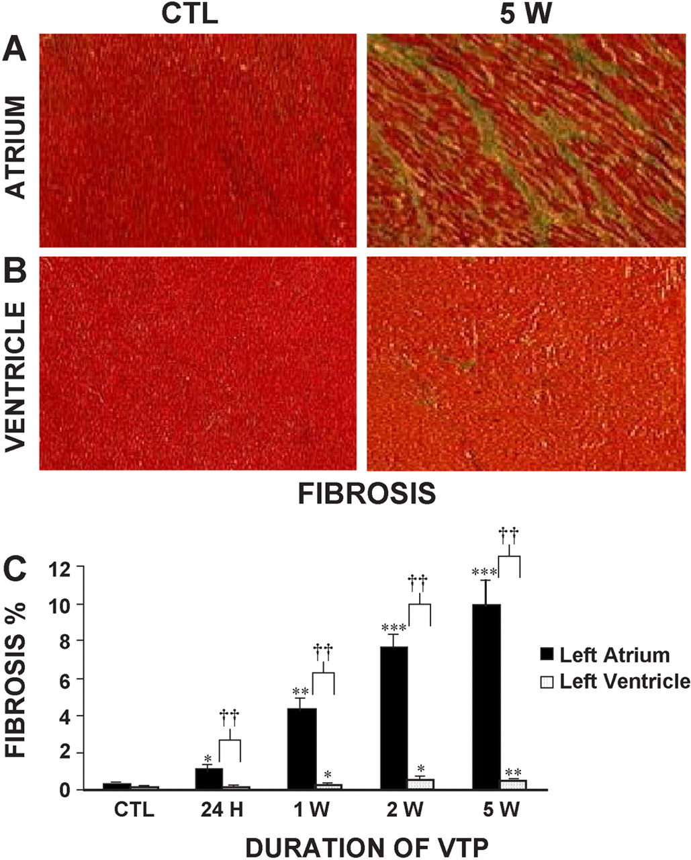
Left Atrium Has More Fibrosis than Left Ventricle in Tachypaced Dogs
Hanna N. et al. Cardiovasc Res (2004)
Notes:
(A) Representative Masson's trichrome stained sections of left atrial tissue from a control (CTL, left) and a 5-week ventricular tachypaced (5 W, right) dog. (B) Representative Masson's trichrome stained sections of left ventricular tissue from the same control and 5-week tachypaced dogs as shown in A. (C) Mean±S.E.M. connective tissue content (expressed as percentage of cross-sectional area) in left atrium and left ventricle in control, 24-h (24 H), 1- (1 W), 2- (2 W) and 5- (5 W) week ventricular tachypaced dogs (n=6 dogs/ventricular tachypaced group, 5 for control). VTP=ventricular tachypacing. Photomicrographic magnifications are 400 × . *P<0.05, **P<0.01, ***P<0.001 compared to corresponding control group. †P<0.05, ††P<0.01, †††P<0.001 for left atrial versus left ventricular values at the corresponding time point.

Slide 14
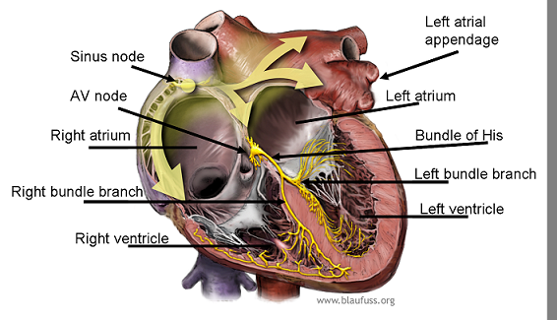
Western Blot Method
Tissue excised from normal or3 week right ventricular tachypaced canine hearts
  Posterior Left Atrium (PLA)
  Left Atrial Appendage (LAA)
Tissue was homogenized
  Whole lysates used for G_{q} blots
  Membrane fraction used for TRPC blots
http://knol.google.com/k/pacemakers#
Notes:
Left atrial tissue samples were homogenized and subjected to anti-Gq and anti-TRPC Western analyses.

Slide 15
Specific Aim 1
Determine if G_{q} mediated Ca²⁺ signaling is up-regulated in AF and/or heart failure.

Slide 16

G_{q} Protein Expression Increases in the PLA after Tachypacing
*
G_{q} Expression Normalized to
MemCode Staining
MemCode Stain
* P < .10

Slide 17
Gene Expression of the 7 Isoforms of TRPC in the PLA
TRPC 1
TRPC 2
TRPC 3
TRPC 4
TRPC 5
TRPC 6
TRPC 7
800
500
Normal
Posterior Left Atrium
300
200
479 bp
462 bp
206 bp
335 bp
550 bp
680 bp
393 bp
TRPC 1
TRPC 2
TRPC 3
TRPC 4
TRPC 5
TRPC 6
TRPC 7
800
Cardiac Titin (368 bp)
500
Tachypaced
Posterior Left Atrium
300
200
479 bp
462 bp
206 bp
335 bp
550 bp
680 bp
393 bp

Slide 18
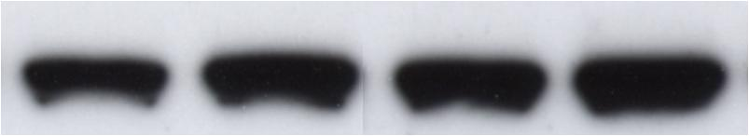
TRPC3 and TRPC6 Protein Expression Does Not Change
Expression Normalized to MemCode Staining
Memcode
Memcode

Slide 19
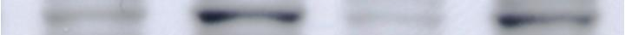
TRPC1 and TRPC4 Increases in the PLA after Tachypacing
*
Expression Normalized to MemCode Staining
* *
Memcode
Memcode
* P < .10, * * P < .05

Slide 20
Store Depletion Activated TRPCs Increased After Tachypacing; TRPCs Activated by DAG Did Not
TRPC4, TRPC5
(Activated by Ca²⁺ store depletion,
high Ca²⁺ selectivity)
TRPC1
(Activated by Ca²⁺ store depletion,
lower Ca²⁺ selectivity)
TRPC3, TRPC6, TRPC7
(Store-independent diacylglycerol activation, non-selective cation channels)
N
C
TRPC2
(Human pseudogene)
Notes:
Interestingly, the TRPC isoforms whose protein expression increased in the posterior left atrium after tachypacing (TRPC 1 and 4) are known to be activated by Calcium depletion of the sarcoplasmic reticulum. Whereas, the TRPC isorforms that did not change after tachypacing, i.e. TRPC 3 and TRPC 6, are known to be directly activated by diacylglycerol.

Slide 21
Specific Aim II
Determine if the upregulation of Ca²⁺ signaling is due to G_{q} mediated activation of TRP channels.

Slide 22
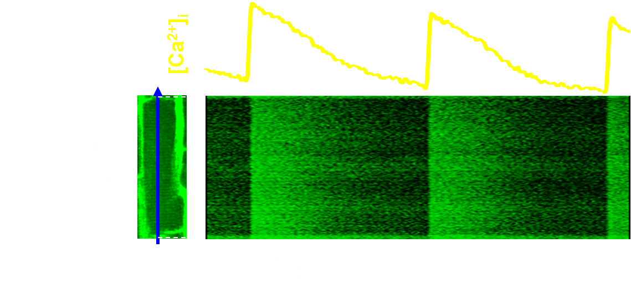
Calcium Confocal Method
Right atrial myocytes isolated from normal vs. right ventricular tachypaced canine hearts
Loaded with the calcium dye Fluo-4
[Ca²⁺]_{i}
Isolated
Myocyte
X-Y
Image
50μM
488nm Laser Line Scan
2000 msec
X-time(t) Line Scan Image
Notes:
. Atrial myocytes were isolated and subjected to calcium confocal studies loaded with the calcium dye, Fluo-4. A confocal microscope was used to generate these linescan images in realtime.

Slide 23
Examples of G_{q} Signaling Evoked Ca²⁺ Dysregulation
Control
10 μM Phenylephrine
Discordant Subcellular Alternans
“Stimulated” Waves
Repetitive Extra Systoles
Notes:
Now in our Ca confocal studies in isolated atrial myocytes, we have observed at least three general forms of Ca dysregulation considered arrhythmogenic can be observed upon stimulation of the Gq-signaling pathway by phenylephrine—a selective alpha-1 adrenoceptor agonist that incluce Discordant Subcellular Ca Alterns, Stimulated Ca waves and or discordant calcium release, and repetitive extra systoles which may be a form of triggered activity.

Slide 24
YM-58483 Abolishes Discordant Subcellular Ca²⁺ Alternans
Control (0.5 Hz stimulation rate)
10 μM Phenylephrine (PE)
10 μM PE + YM-58483
10 μM PE, after washout of YM-58483
After washout of PE

Slide 25
YM-58483 Inhibits Waves in Tachypaced Canine Myocyte
Control (0.5 Hz stimulation rate)
10μM YM-58483
After washout of YM-58483
Notes:
in isolated atrial myocytes from a tachypaced heart we see spontaneous generation of arrythmogenic calcium activity. When we add YM-58483 this activity is abolished, but it is reversible when we washout with tyrode’s solution.

Slide 26
PYR3 Abolishes Discordant Subcellular Ca²⁺ Releases
Control (0.5 Hz stimulation rate)
10 μM Phenylephrine (PE)
10 μM PE + PYR3
10 μM PE, after washout of PYR3
Notes:
Given the TRPC expression results, we wanted to see if we could inhibit activity using commercially available TRPC inhibitors. BTP-2 is a generic TRPC inhibitor and in isolated atrial myocytes from a tachypaced heart we see spontaneous generation of arrythmogenic calcium activity. When we add BTP-2 this activity is abolished, but it is reversible when we washout with tyrode’s solution.

Slide 27
Specific Aim III
Modulate the upregulation of Ca²⁺ signaling using a novel G_{q} inhibitory peptide.

Slide 28
C-terminal G_{q}α Inhibitory Peptide
Peptides mimicking the extreme C-terminus of G_{x}α subunit selectively disrupt the corresponding G_{x}-protein signaling.¹⁻⁴
Hence, we use a cell-penetrating G_{q}α C-terminal peptide to effect selective attenuation of G_{q} signaling in isolated canine atrial myocytes:
RRRRRRRRR--LQLNLKEYNLV
cell-penetrating
moiety
G_{q}α C-terminus
moiety
¹Rasenick MM et al. (1994) J. Biol. Chem. 269:21519-21525.
²Chang M et al. (2000) J. Biol. Chem. 275:7021-7029.
³Gilchrist A, Mazzoni MR et al. (1998) J. Biol. Chem. 273:14912-14919.
⁴Deng X et al. (2008) Mol. Biol. Cell 19:2520-2533.

Slide 29
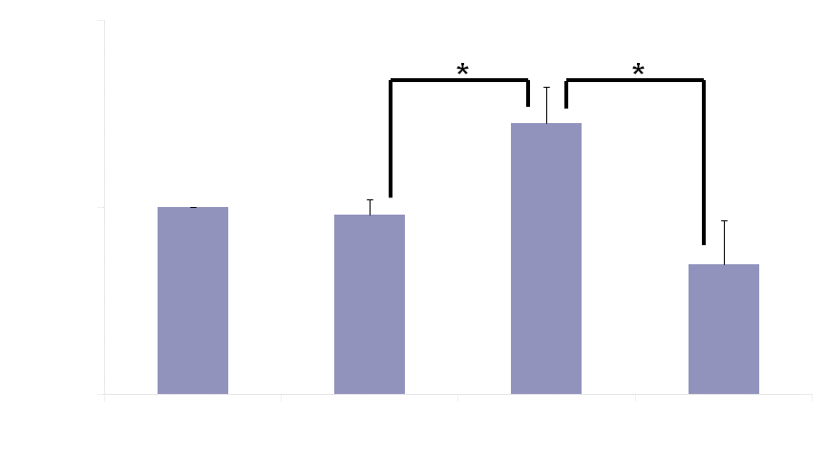
G_{q} Peptide Prevents Phenylephrine Induced Increase in IP₃ Generation
Isolated Canine Atrial Myocytes
Notes:
As a general test of the cp-Gqalpha peptide effectiveness, we demonstrated its ability to attenuate PE-induced IP3 production in isolated atrial myocytes (IP1 ELISA…IP1 is a more stable downstream metabolite of IP3).

Slide 30
G_{q} Peptide Prevents Phenylephrine Induced Aberrant Ca²⁺ Cycling
Control (0.5 Hz stimulation rate)
10 μM Phenylephrine (PE)
10 μM PE + 300nM cp-G_{q}α C-terminal peptide
10 μM PE, after washout cp-G_{q}α C-terminal peptide
Notes:
In isolated atrial myocytes, here again we show arrhythmogenic Ca activity induce upon PE application, which upon application of the cp-Gqalpha inhibitory peptide was abolished (which was reversible).

Slide 31
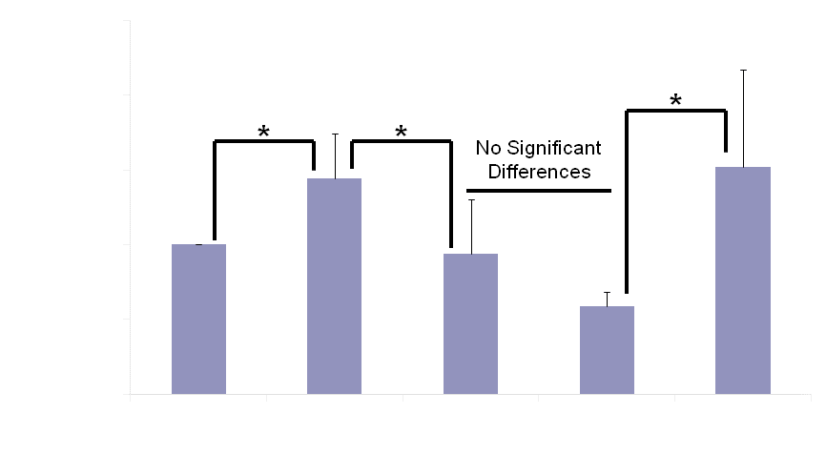
G_{q} Peptide Prevents Phenylephrine Increase in Ca²⁺ Transient
Isolated Atrial Myocytes from 3 Week Ventricularly-Tachypaced Canine
Notes:
This is a quantitation of the previous slide, in which we see phenylephrine increases the calcium transient amplitude approximately 50% and the addition of the Gq peptide brings the amplitude back down to control levels. Treatment with phenylephrine and the Gq inhibitory peptide, blocks this 50% increase in amplitude. When the peptide is washed out with phenylephrine, we see the 50% increase in amplitude recovers.

Slide 32
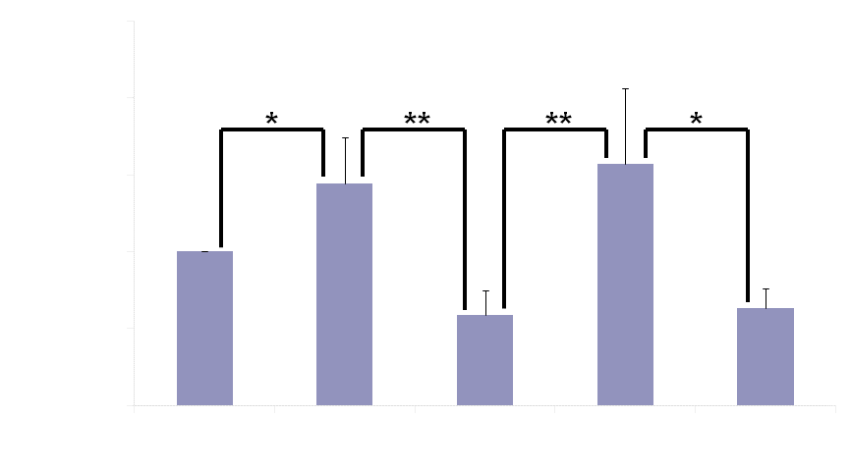
Randomized G_{q} Peptide Does Not Affect PE Induced Aberrant Ca²⁺ Cycling
Isolated Atrial Myocytes from 3 Week Ventricularly-Tachypaced Canine
Notes:
This is a quantitation of the previous slide where again we see Phenylephrine induces a 50% increase in the amplitude of the caclium transient and the addition of Gqr with Phenylephrine does not inhibit this 50% increase.

Slide 33
Summary
↑G_{q} protein in PLA after 3-4 wk RV tachy-pacing
↑TRPC1, TRPC4 in PLA after 3-4 wks RV tachy-pacing (no change in TRPC3 and TRPC6)
TRPC channel inhibition abolishes G_{q}-mediated arrhythmogenic Ca²⁺ dysregulation in atrial myocytes
Disruption of GPCR-G_{q} coupling abolishes arrhythmogenic Ca²⁺ dysregulation (and IP₃ generation) in atrial myocytes
Notes:
To summarize, we saw that G_{q} protein expression is upregulated in PLA after tachypacing. The G_{q} inhibitory peptide inhibits PE-induced IP₃ generation. We also saw that TRPC1 and TRPC4 are upregulated in the PLA after tachypacing while TRPC3 and TRPC6 remain unchanged. The G_{q} inhibitory peptide inhibited the PE-induced arrythmogenic Ca²⁺ activity in tachypaced myocytes. While both the Broad spectrum TRPC inhibitor BTP2 and TRPC3 inhibitor PYR3 inhibited spontaneous arrythmogenic Ca²⁺ activity in tachypaced myocytes.

Slide 34
Model
α₁ adrenoceptors
Angiotensin₁ receptors
Endothelin_{B} receptors
Cardiomyocyte
G_{q}PCR
TRPC
Na⁺/Ca²⁺
Exchanger
PIP₂
IP₃
PLC
DAG
G_{αq}
IP₃R
Sarcoplasmic Reticulum
Triggered Activity
Delayed Afterdepolarizations
T tubule
Notes:
An action potential travels down the T tubules, depolarization spreads through the T tubule, calcium is released from the sarcoplasmic reticulum, Calcium binds to troponin.
Troponin changes shape and pulls tropomyosin out of the myosin head binding sites.
and myosin binds actin. approximately 20 milliseconds after stimulation, the peripheral Ca²⁺ signal can reach 1 µM. However, owing to the lack of inward spreading, the Ca²⁺ concentration declines sharply with distance away from the sarcolemma, and the centre of the cell barely shows an increase over the normal prestimulated Ca²⁺ level of 100 nM

Slide 35
Cp-Gq Peptide
Phenylephrine
Angiotensin
Endothelin
cp-G_{q}α
Cardiomyocyte
G_{q}PCR
TRPC
Na⁺/Ca²⁺
Exchanger
PLC
G_{αq}
IP₃R
Sarcoplasmic Reticulum
T tubule
Notes:
An action potential travels down the T tubules, depolarization spreads through the T tubule, calcium is released from the sarcoplasmic reticulum, Calcium binds to troponin.
Troponin changes shape and pulls tropomyosin out of the myosin head binding sites.
and myosin binds actin. approximately 20 milliseconds after stimulation, the peripheral Ca²⁺ signal can reach 1 µM. However, owing to the lack of inward spreading, the Ca²⁺ concentration declines sharply with distance away from the sarcolemma, and the centre of the cell barely shows an increase over the normal prestimulated Ca²⁺ level of 100 nM

Slide 36
Conclusions
Accentuated atrial G_{q} signaling, which can occur in pathological hypertrophy/CHF, contributes to arrhythmogenic Ca²⁺ dysregulation.
This atrial G_{q}-mediated arrhythmogenic Ca²⁺ dysregulation can be attenuated via inhibition of TRPC channels and/or by disrupting GPCR-G_{q} coupled signaling.

Slide 37
Future Experiments
Repeat westerns in Human tissue
Continue Ca²⁺ confocal studies in normal and isolated canine atrial myocytes
Inject and electroporate G_{q} inhibitory peptide and conduct electrophysiology studies
Administer TRPC inhibitors and conduct electrophysiology studies

Slide 38
Acknowledgements
Hemanth Koduri
Paloma Pina
Suzanne Browne
Aria Mohtadi
J Andrew Wasserstrom
Jeffrey Goldberger
Alan Kadish
Rishi Arora
Gary L Aistrup

